Slide 1
Profile Manual
This new logo and profile set is built in part on the old design,
and developed by Glenn Slotte and Øyvind Steensen, with input from BIEN.

Slide 2
This is the main logo of BIEN - Basic Income Earth Network. Can be placed on many backgrounds, but preferably white or bright.
Alternative black and white version used on white backgrounds where colors are not available.

Slide 3
Alternative main logo. It should be used where one can place it on a white background.
This version can be used on white backgrounds where color is not available.

Slide 4
BIEN material may have a background with the purple BIEN color. Use the white transparent version in these cases.
The white transparent version can also be used in situations where the background is black...

Slide 5
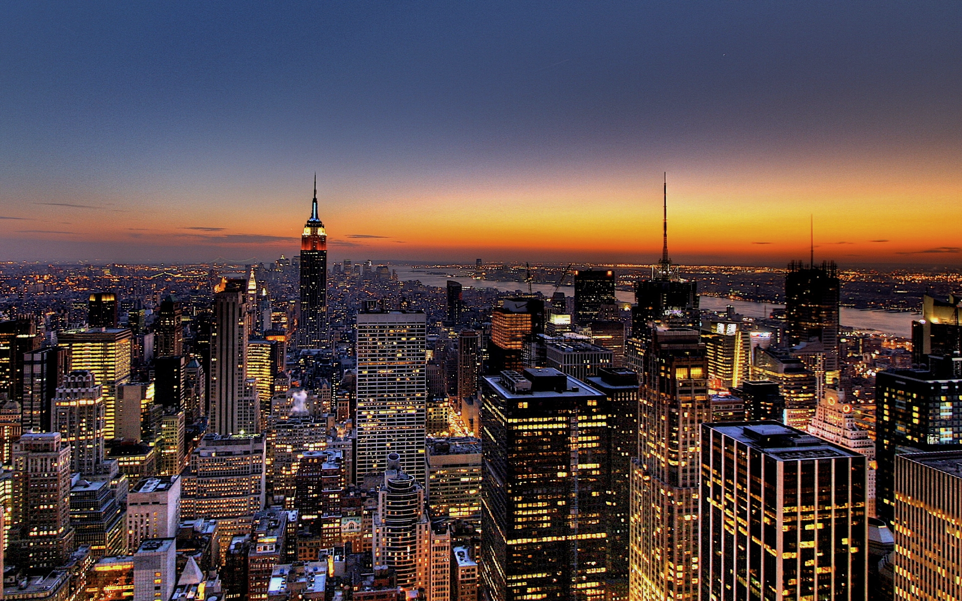
…and where the logo can be placed on a relatively clean and dark background.

Slide 6
This framed version should be used on noisy backgrounds like busy photos. It should be used when the background is uncertain and supplied whenever the logo placement is outside of the control of BIEN designers.

Slide 7
Miniature set
This logo set is lacking the small text «Basic Income Earth Network» and should only be used wherever the logo will be viewed in such a small format that the small text would be confusing and/or unreadable.
As with the main logo, this variant has a full set that comes with the same guidelines for use.
Horizontal set
Some spaces may be wide but lacking vertical space. If the main version looks insufficient, this logo set can be used.
As with the main logo, this variant has a full set that comes with the same guidelines for use.

Slide 8
Localized and affiliate logo versions
This is the logo for the affiliated BIEN organization in Norway. Custom versions can be made for any affiliated organizations who wish to use this design.

Slide 9
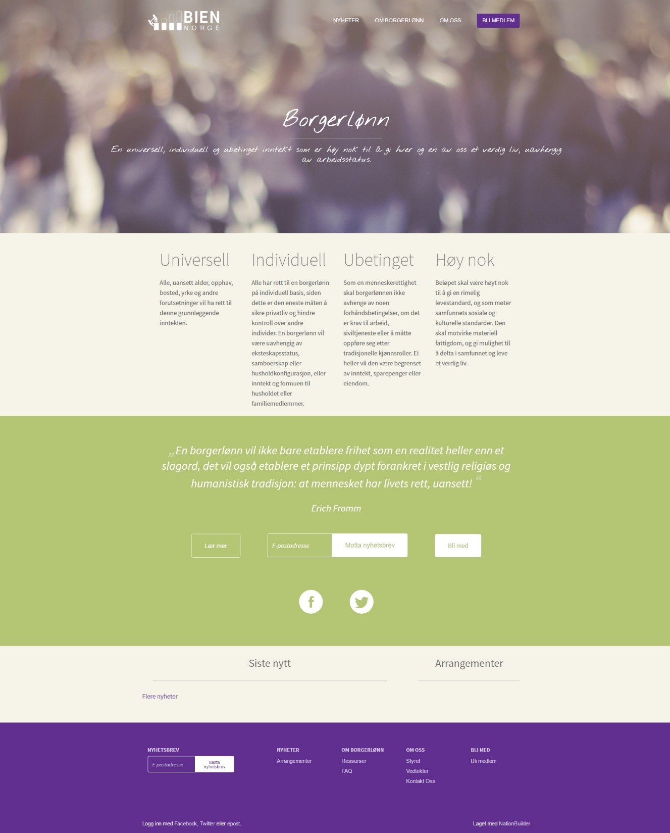
Profile example The new website for BIEN Norway, built by Glenn Slotte and designed by Glenn Slotte and Øyvind Steensen.
Check it out at borgerlonn.no

Slide 10
Support color A
(Mainly for variation on elements)
CMYK (for print material):
#b4c574
RGB (for digital material): R:180 G:197 B:116
The BIEN color
CMYK (for print material):
#602f8f
RGB (for digital material): R:96 G:47 B:143
Support color B
(Mainly for backgrounds)
CMYK (for print material):
#f4f2e9
RGB (for digital material): R:244 G:242 B:233
Support color C
(Mainly for text)
CMYK (for print material):
#71706b
RGB (for digital material): R:113 G:112 B:107
Support color D
(White. Mainly for backgrounds or text)
CMYK (for print material):
#ffffff
RGB (for digital material): R:255 G:255 B:255

Slide 11
Margins
The logo should not be closer to another object than about the height of the tallest bar in the logo (a), which is about half the height or width of the main logo. However, margin space is more important horizontally than vertically. In the narrowest vertical spaces, the bottom part of the bars (b) may be enough margin for top and bottom.
These margins, based on the height of the bars (a and b), should also be applied to any framed logo, from the edge of the logo frame and outwards.
a
b
a
a
b
a
b
a
a

Slide 12
Fonts
The font used in the logo is Century Gothic Regular with horizontal scale set to 72,62%.
The font otherwise used in this manual is Calibri Light.
File types
All versions of the logo are provided as vector graphics in .pdf-format and bitmap graphics in .png-format.
Vector graphics have no resolution and look smooth in any size. This is the default format that should be used for print and most design tasks. These also functions as the raw source files. Bitmaps of any resolution can be exported from the vector versions.
Bitmap graphics consist of many small dots, like the image on a digital monitor. This type of graphics can be shrunk quite successfully, but when scaled up, it becomes blurry and/or pixelated. All logos have been provided as a bitmap with relatively high resolution as well as versions fitting the profile and banner pictures of Facebook of 2015. Other resolution bitmaps can be exported from the vector files, but make sure to export with transparency, as supported by the .png-format.
Profile manual by Øyvind Steensen. E-mail: oyvindss@gmail.com Web: steensenvisuals.no

