Slide 1
Experimenting Basic Income (BI) in Finland
NORDIC BIEN -meeting
Copenhangen 22.-23. September 2016
Olli Kangas (olli.kangas@kela.fi)
Professor, Director of Governmental Relations
Kela, Social Insurance Institution of Finland

Slide 2
BACK GROUND: Why a BI experiment?
The Center-True Finns-Conservatives coalition cabinet (nominated 28. May 2015) took basic income experiment in its working program
BI is seen as a solution to a number of problems:
  Changes in the labour markets / non-standard employment
  To abolish / mitigate monetary disincentives
    Income-tested basic benefits paid on top of each other create high effective marginal tax rates of 80-100%
      Eg. labour market subsidy + housing allowance + social assistance and income-related day care fees
    Making all work pay
  Bureaucratic traps
    Shifts in employment / social security statuses may cause problems and uncertainty among the benefit recipients
  To simplify and tighten the basic security safety net

Slide 3
Steps towards the experiment…
€20 Mill. for the experiment
  Some extra funds for planning the experiment
Open competition on the funds
  15. September 2016 Kela’s consortium was selected to plan the experimental setting and the model(s)
Work began in the mid-October 2016
The first report delivered 30. March 2016
The final report is due 15. November 2016.
The experiment starts 1.1. 2017 and lasts 2 years

Slide 4
Mission impossible: tasks given by the Government
TO STUDY…
Which models are the most suitable for the experiment
  What is the level of the monthly payment
How to combine BI with income-related benefits and other basic benefits
Tax treatment of different models
What are the strengths and weaknesses of different models in the context of the EU legislation and the Finnish Constitution
Give recommendations on the experiment

Slide 5
Models explored and developed
Full basic income (BI)
  The level of BI is high enough to replace almost all insurance-based benefits
  Must be rather a high monthly sum, e.g.1 000€-1 500€. Realistic?
Partial basic income
  Replaces all ’basic’ benefits but almost all insurance-based benefits left intact
  Minimum level should not be lower than the present day minimum level of basic benefits (€ 550 - € 600 a month)
  Plus income-related benefits and housing & child allowance
Negative income tax
  Income transfers via taxation system
Other models
  Perhaps low BI plus ’participation’ income

Slide 6
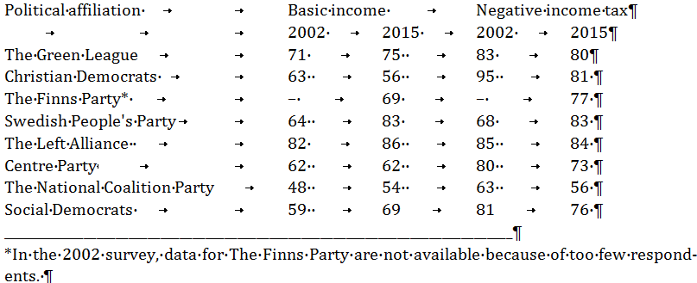
Strong public support? Or not?
The support went down to
  35 per cent for BI of €500 with flat rate tax of 40% collected from income exceeding the BI.
  BI of €800 and tax rate of 55% were supported by 29% of Finns.
Cheap vs. expensive support and commitment
  Idea is supported but not the actual model

Slide 7
Party attitudes on BI in Finland 1979-2015 (Perkiö & al. 2016)

Slide 8
The experimental setting planned by the expert group (by 30 March 2016)
The entire adult population excl. pensioners) is used as a basis for the sample
  age and income selection criteria
  low-income earners
  25 and 63 years of old
  Weighted sample of particularly interesting groups
Nation level randomization to get representative results for the whole country
local experiments in order to capture networking, institutional and interaction effects and externalities
  A number of municipalities with 10%, 30% random sampling.
To increase the sample size:
  Kela benefits will be used as a source of extra funding (sample 9,000)

Slide 9
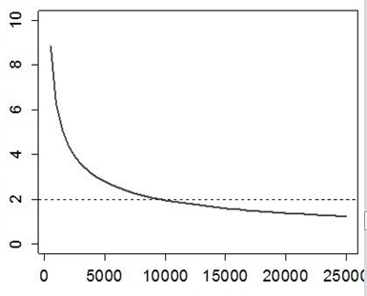
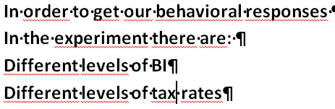
Experimental setting
Significant effect
Model | BI € | Tax rate
A0 | 590 | PRESENT
A1 | 590 | 40%
A2 | 590 | 45%
B1 | 690 | 45%
B2 | 690 | 50%
Sample size

Slide 10
Bill on the experiment was sent 25. August 2016 for public hearing
2 000 (possibly 3 000) unemployed who get flat-rate benefit from Kela
  Random selection into the treatment group
  The rest of the Kela unemployed (app. 130 000) form the control group
The follow up studies:
  Registers on income, employment, use of medicine, medical treatment
  Surveys and interviews on:
    Other aspects of welfare
    Experiences on bureaucracy
BI 560€ net a month
Present taxation on income exceeding 560€
Social benefits exceeding 560€ will be paid out as previously
  Nobody will loose
  Housing allowance and social assistance are tested against basic income
Work income ’float’ on BI
Obligatory participation
1.1. 2017 ends 31.12.2018

Slide 11
WHY THE EXPERIMENT WAS SQUEEZED?
Constitutional constraints
  Question on equal treatment
    Different levels and different tax systems ruled out
Tax authorities not involved in writing the law
  Tax-free benefit & present tax system
Only Kela unemployed
  Easy to make a random sampling
  Easier to write a law for one specific group than for many groups
  Kela benefits can be used for experimental purposes
Other legal constraints
  Implementing BI in a complex institutional setting is very demanding
Time pressure
  To write and pass the legislation
  To create a ICT platform for paying out the benefit
Changing Kela’s ICT systems limited the size of the treatment group
  Partially manual decisions and payments

Slide 12
Reactions on the Bill
Christian Democrats
  Universal Credit would be better
Center
  Why youth excluded?
  Not a perfect model, but good enough to start with
Economists
  Not a model for general implementation
  Focus on the unemployed is well-motivated
  Good enough
  Employment effects are the effects among the group selected to be the target group of the experiment
Social democrats
  This is a joke and nonsense
  How a researchers who have self-respect can suggest this kind of bullshit
The Greens
  A deliberate falsification of the idea of BI
  Fully stupid experiment
Left wing
  Where are the young, students, free lancers, micro entrepreneurs, other self-employed?
  No reliable results

Slide 13
What next?
Dead-line for public hearing was 9. September 2016
the Ministry of Social Affairs will reform the Bill
The Bill will be sent to special inspection to parliamentary committees – Constitutional committee is the most decisive
  Is it possible to carry out nation-wide experiments with humans?
    Previously municipal experiments are allowed
At Kela we are planning the sampling and information to be sent to the treatment group, preparing ICT systems, training the staff needed for running the benefit, etc….
The rest is highly a political process and whatever can happen
Final report due to 15, November 2016

Slide 14
AT PRESENT IT SEEMS THAT A WIDER EXPERIMENT BEGINS 2018
Critics against the model presented in the bill
  1. Too small sample
    Can easily be expanded to 6 500 person
  2. Only unemployed
    Other groups are ‘expensive’
  3. Tax system not present
  4. Not local experiment (can be expanded cf. 1.)
BUT the question is about money
  Experiment budget is €20 Mill
    €6 Mill will be used for the pilot study of the 2017
  1 000 persons without Kelan benefits will cost €14 Mill
  If taxes collected on income exceeding BI can be used for experiment the sample can be expanded
Obligatory vs. voluntary?
Extra resources?

Slide 15



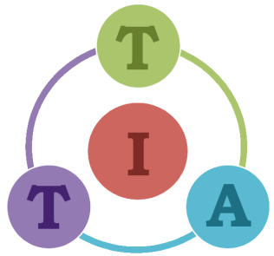

Economic Research Center VATT
University
of Tampere
Indipendence Foundation SITRA
Tackling Inequalities
in Time of Austerity

