Slide 1
Unconditional Basic Income in a Nation Obsessed With Labour – How Do We Break the Taboo and Find Ways Forward?
Annika Lillemets, Member of Parliament, Green Party
Notes:
Interest for BI is surging all over the world. We have heard of many inspiring examples, also from countries that are comparable with Sweden. So how come the concept is next to taboo in Sweden? How do we break the taboo and find ways forward?
Times are changing, unlike the mindset of the Swedish political elite. Its desperate clinging to organizations and ideas of the past and its obsession with labour at any cost effectively blocks urgently needed debate and reforms. Whereas open-minded political leaders in nations like Finland, the Netherlands and Canada dare to try various versions of unconditional basic income, the concept is taboo within Sweden’s ruling elite. Meanwhile, interest in UBI is surging in the Swedish society, not least within the ever larger groups of people who are suffering from ever worse conditions in the labour market and excluded from the Swedish social security systems that were designed for a past era.There is an urgent need to find viable alternative ways forward. How can the taboo be broken and by whom? What solutions and what arguments might appeal to people and the elite in a society like Sweden with its deeply rooted culture of work ethics and worship of labour? Can some kind of unconditional basic income become part of an updated Nordic Model?

Slide 2
”ARBETSLINJEN”
Notes:
An obsession with labour prevails in Sweden, especially among the political elite but it is also deeply rooted in large segments of the population.
Arbetslinjen is a holy grail. I have asked scholars like Roland Paulsen, but there is no translation. Arbetslinjen is a Swedish word and concept.
Work-first principle, workfare, labourism, workerism… all those have been suggested but doesn’t fully describe what it means.
Arbetslinjen definieras av Nationalencyklopedin som ”en huvudprincip i svensk arbetsmarknads- och socialpolitik som innebär att man i första hand ska erbjuda arbete eller utbildning istället för understöd eller bidrag till dem som blivit arbetslösa” (NE, 2012).
Arbetslinjen is a social political principle that emphasizes measures that primarily attempt to give the unemployed jobs instead of assistance in the form of allowance. This line was developed in Sweden between the years 1914 and 1920, and the term itself was used as early as the 1920s.
Arbetslinjen has been the main theme of the Moderate Party since 2005 and the core of former Prime Minister Fredrik Reinfeldts policies with lower taxes for low and middle income earners, reduced allowance and increased focus on reducing exclusion. It has become ever more repressive, more moralstic and paternalistic.
Enligt statsvetaren Simon Birnbaum uttrycker begreppet "den etablerade princip i svensk politik som uttrycker tanken att arbetsförmögna aktivt måste söka avlönat arbete eller gå någon godkänd aktiveringskurs eller utbildning för att kvalificera till bidrag". Med den definitionen kan exempelvis medborgarlön aldrig förenas med arbetslinjen. Inte heller arbetsfria inkomster är förenliga med arbetslinjen.

Slide 3
Where will we find political courage and open minds in Sweden?

Slide 4
Not here…
Notes:
Social democrats: paternalistic tradition, perhaps more so than in other Nordic countries. Eg the 30’s, Myrdals, social engineering.
World record in government in a democratic state, between 1932 and 1976 >40 år, 44 år. The labour movement including its parliamentary branch started as an emancipatory project, that gradually ossified as a power apparatus, it is a good example of this process that Sartre described. Labour movement: administration.
The self-proclaimed new workers’ party, right wing Moderates, won the election 2006 with three smaller right wing parties. They immediately made it worse; arbetslinjen turned more repressive. It should hurt being sick or unemployed, utanförskap. Massive tax reductions for income earned from labour.
This has basically not changed with the S+MP minority government 2014.
Strong work ethics.

Slide 5
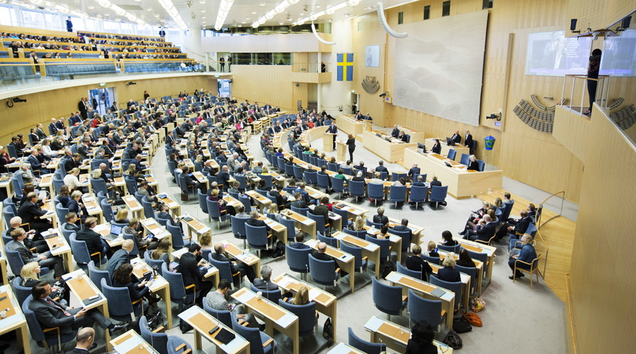
… and not here
Notes:
8 MP’s declared that they were in favour of BI before the election 2014, one Social Democrat, one Leftist and the rest Greens. A number of motions to Parliament by Green MP’s demanding Public Investigations and in some cases pilots, and also cap and dividend or similar fee and dividend systems for carbon dioxide, plus motions demanding that part of Sweden’s development aid would be unconditional cash transfers.
2010-1014 when we were in opposition a few of us greens tried to raise the issue by writng questions, interpellations to ministers, thus forcing them to debate.
Friår - sabbatical year, an initiative by the Greens (initially suggested by Gösta Rehn) He started to work as an economist for the Swedish Trade Union Confederation in 1930, being this his full-time employment since 1943. From 1973 to his retirement, he was professor of labour market policy at the Institute of Social Research. 1974, OECD meeting. However, the LO demanded its abolition.
Very difficult to initiate even a debate, no arguments.

Slide 6
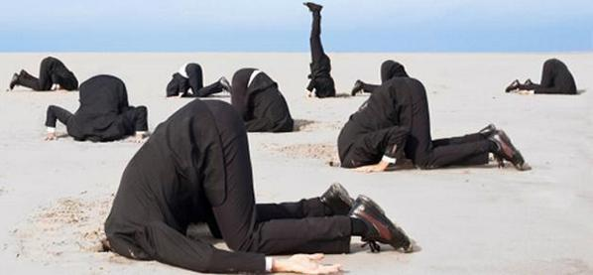
Why…?
Notes:
All we hear is more of the same – create jobs, no matter if they are needed or useful.
Why?!
Strong consensus culture in Sweden. Loyalty with party elites.

Slide 7
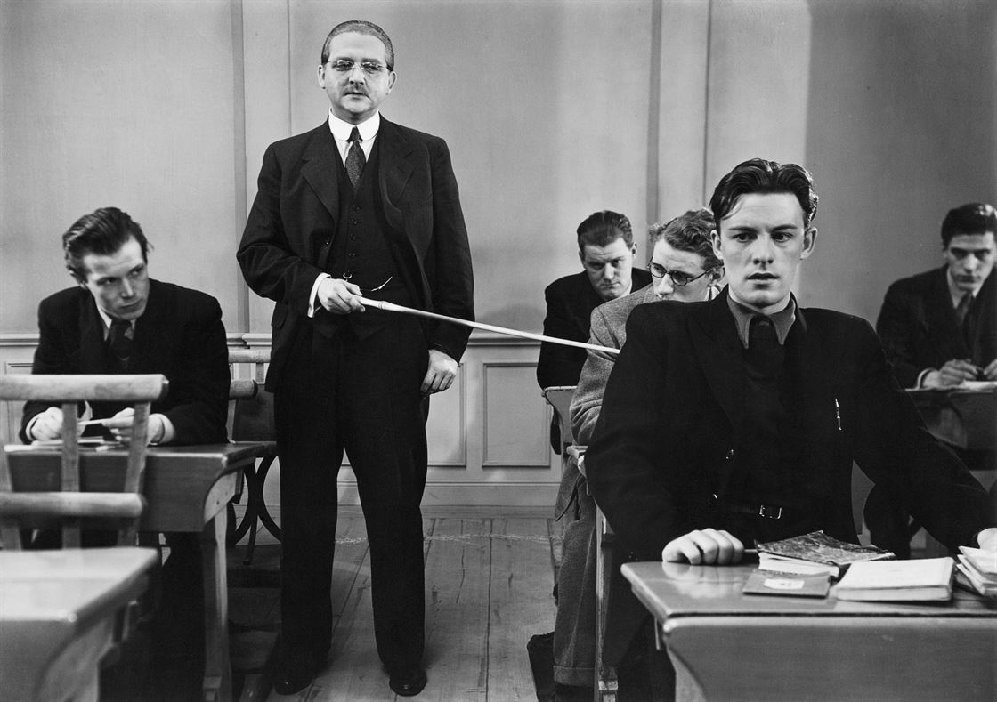
Why…?
Notes:
All we hear is more of the same – create jobs, no matter if they are needed or useful.
Why?!
Strong consensus culture in Sweden. Loyalty with party elites.

Slide 8
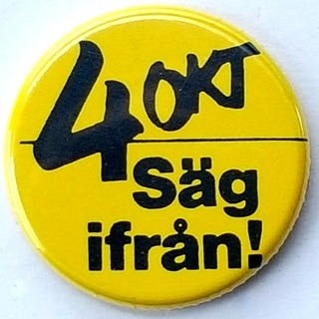
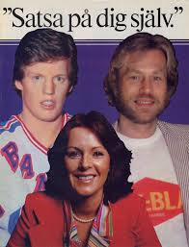
”Satsa på dig själv”- ”Invest in your self” - campaign by the Confederation of Swedish Enterprise
Notes:
One component contributing to the anxious and coward attitude: the revolving doors between politics and big business and lobby agencies.
Ulf "Lill-Pröjsarn" Nilsson, ABBA-Frida, Anders Hedberg 1979

Slide 9
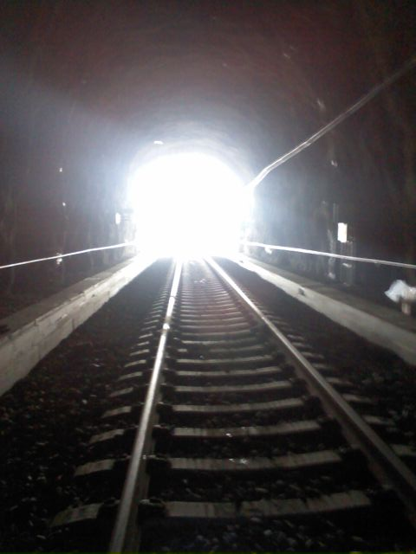
Public debate surging
New movements
Next election in 2018
Notes:
Something has happened!
Networks are established and grow. Surge in interest since somewhere round 2012. Guy Standing attracts large audiences and is invited to mainstream events.
Pirate party and others that are still not in Parliament.
Articles in mainstream media, various political positions.
Digitalisation.
Even new party.
Will the established parties get it? Or continue with more of the same.
I don’t think Sweden will catch up but I hope to be proven wrong.
I don’t see anyone coming in the established parties, such as Corbyn, but who knows?
Generation shift?

Slide 10
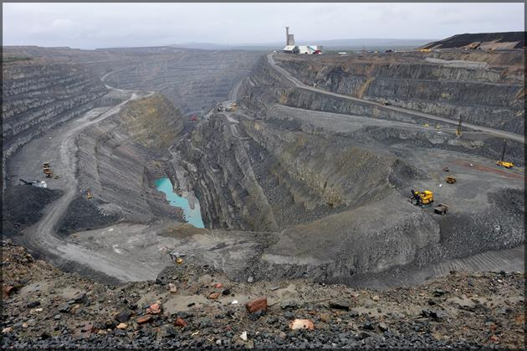
Will the North revolt?
Notes:
In August Lotta Gröning, an editor of one of Sweden’s major newspapers, suggested that the northern part of Sweden should demand independence.
This provocation spurred a reaction.
The situation is colonial. Widespread frustration and anger.
Vattenfall decided to move its office in Jokkmokk, spurred a rebellion.
Articles about UBI for rural communities.
Perhaps some fee and dividend system might be more feasible and acceptable for larger groups than redistribution from high wages? Mineral tax almost zero.
Relaxing control and workfare? Not likely, in my opinion.

