Slide 1
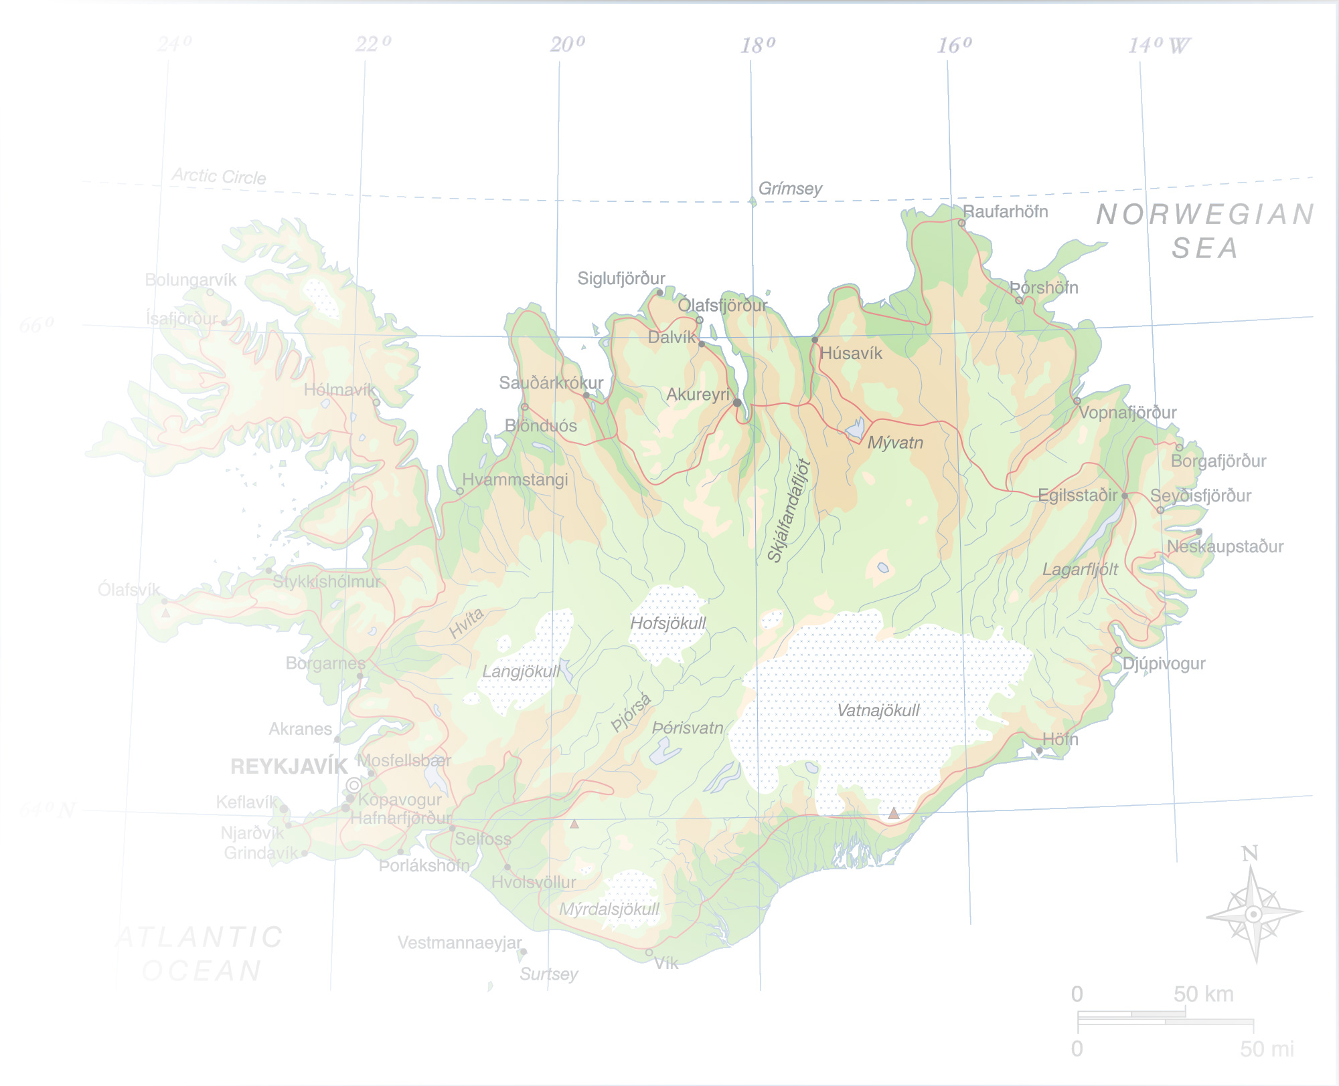
Basic income possibilities
According to an Icelandic Pirate
Albert Svan Sigurdsson, Pirate Party Iceland
Copenhagen 23.9.2016

Slide 2
Iceland
Population: ~320.000 persons
Lowest salaries now ~1300 EUR/month (170.000 ISK)
Calculated minimum income level ~1700 EUR/month (~230.000 ISK)

Slide 3
Plan for a negative income tax
Full basic income: ~4600 billion EUR (~600.000 billion ISK)
In Iceland everyone has a “personal tax credit” (tax deduction scheme)
We are proposing unused “personal tax credit” should be payed to persons
We propose to remove all conditions for social benefits and similar payments
Then we propose the personal tax credid be raised slowly
When “personal tax credit” reaches basic income level we have effective negative income tax.
Note: Minimum wage should be made ~20-30% higher

Slide 4
Pilot project for full Basic Income
Testing the theory in Iceland
My suggestion: Akureyri area in North of Iceland
Ca. 20.000 persons
Quite isolated labour area
Quite diverse labour and incomes
Hospitals and schools
Worth checking and discussing

Slide 5
http://www.diva-portal.se/smash/get/diva2:786106/FULLTEXT01.pdf

Slide 6
Tax schemes in the Nordic Countries

Slide 7
Abstract
In Iceland the Pirate Party is preparing a policy for implementing basic income in Iceland. The debate initiated a couple of years ago when congresswoman Mogensen proposed a legislation on basic income at the Icelandic Parliament.
Some prelimenary calculations show that ⅓ of the Icelandic government budget already goes to direct money transfers to Icelandic individuals and that a modest basic income amount for all persons 18+ old will cost ⅔ of the budget while a negative income tax may cost a similar amount as the current social financial aid.
Of many prerequisites one initial observation is that a regular calculation of basic income criteria should be calculated regularly and that a legislation of lowest allowed salaries must be somewhat higher than the basic income criteria.

Slide 8
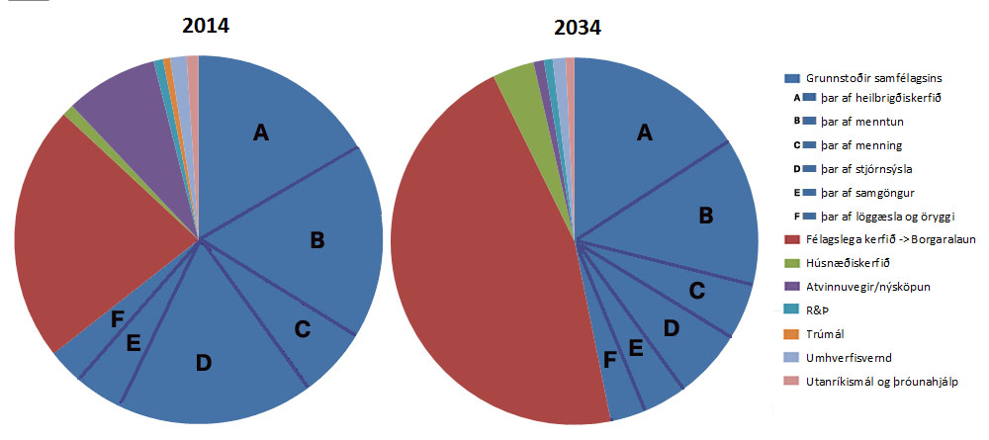
A government expenditure scenario (my very own ideas)
Infrastructure
Health care
Education
Culture
Government
Roads / communication
Domestic security
Social aid / Basic income
Housing
Industries / activities
Research / development
Religion
Environment
Foreign affairs

Slide 9
GDP: 15 billion EUR/year (~1800-2000 billion ISK)
Government income/expenditure 7-8 billion EUR/year (~900-1000 billion ISK)
Government social payments ~2000 billion EUR/year (~260.000 billion ISK)

